Slide 1
Data Modelling and Relationships
a.occhipinti@tees.ac.uk
Dr Annalisa Occhipinti

Slide 2

Outline
What is a data model (examples)
Data Normalisation
Relationships in Power BI

Slide 3
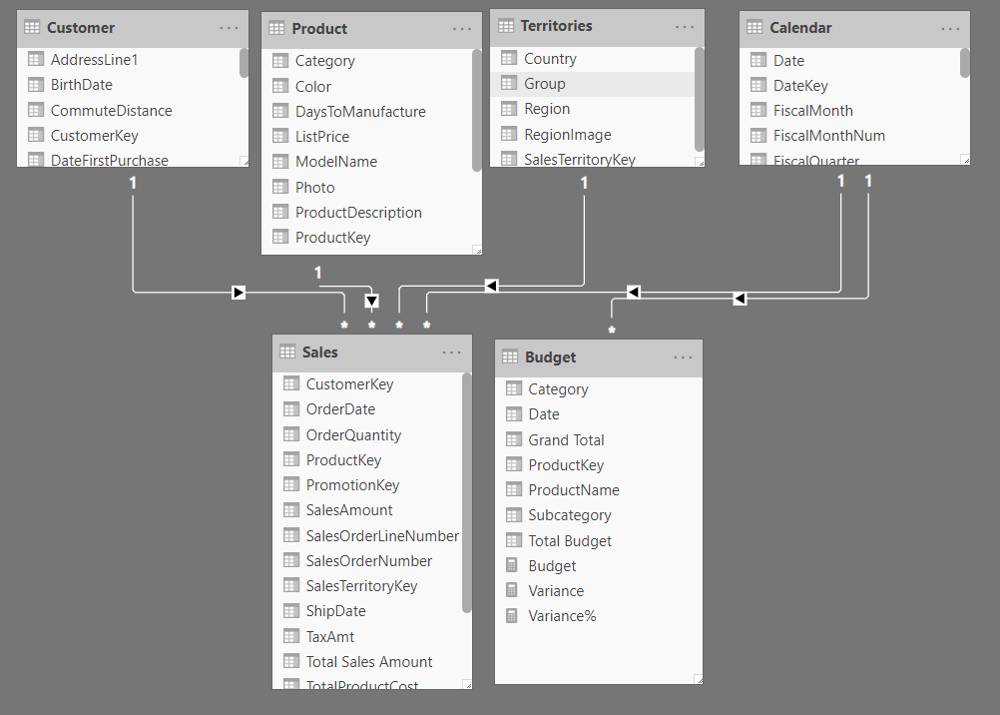
What is a Data Model?
Collection of tables connected through relationships

Slide 4
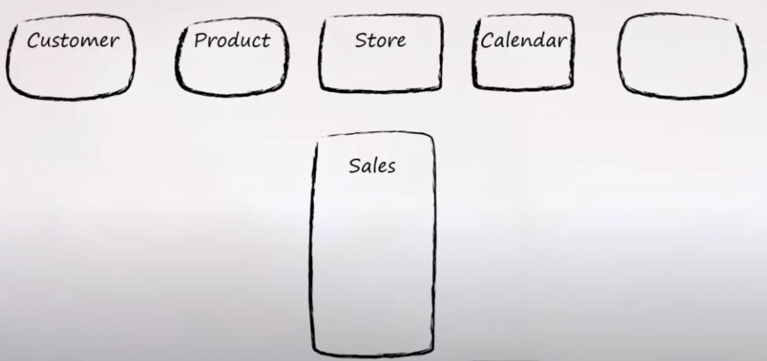
A basic BI Model

Slide 5
A basic BI Model
Fact Table | Dimensions – Look up Tables
Business Process | Who, What, Where, When, How
Tall and Skinny | Short and “fat” ☺
Numbers | Words
Notes:
https://www.youtube.com/watch?v=pvIVMEFQokE&list=PL7GQQXV5Z8efbHd_ITKTALtncsqhBAqZt&index=1

Slide 6
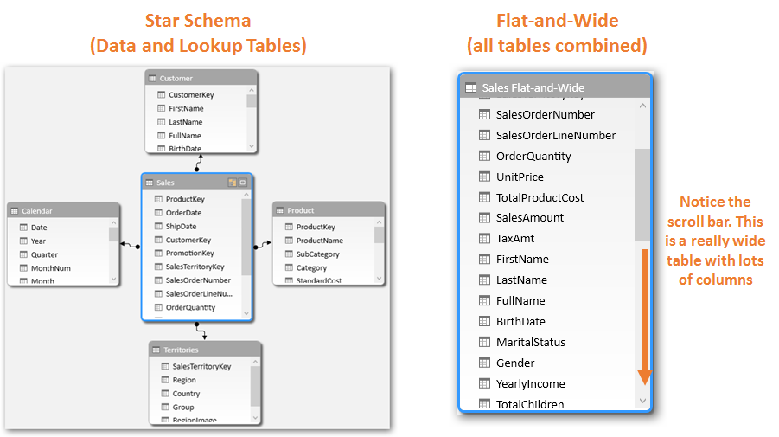
Fact and Dimension tables
Fact Tables
Changes a lot – Transactional dataset, new rows every time there is a new transaction
Dimensions Tables
They give context to fact table. They don’t change a lot. Customer Data Base, slow changes, or Product Tables (you don’t develop new products all the time)

Slide 7
Why can’t I use one single Flat Table?
Disadvantages:
Poor performance (table is so big, takes a lot of time to scan all the rows/columns)
Poor usability (it takes time to understand what the table describes)

Slide 8
Examples of Data Models
Good examples and not so good examples

Slide 9
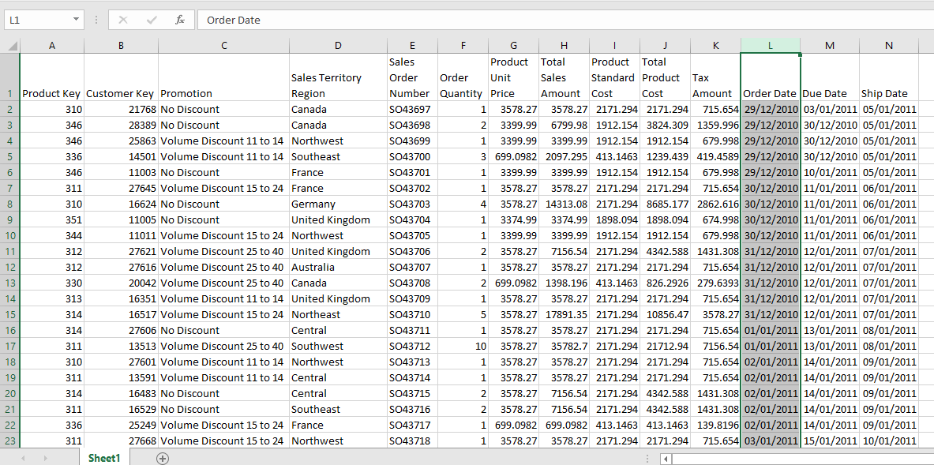
Example 1

Slide 10
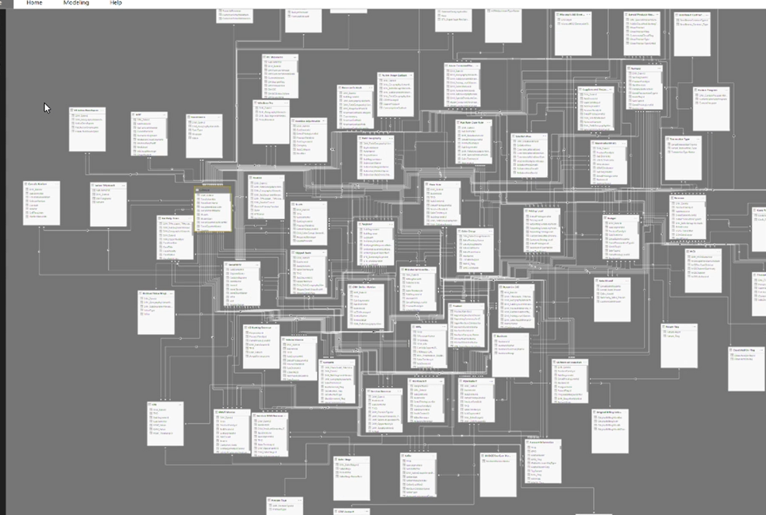
Example 2

Slide 11
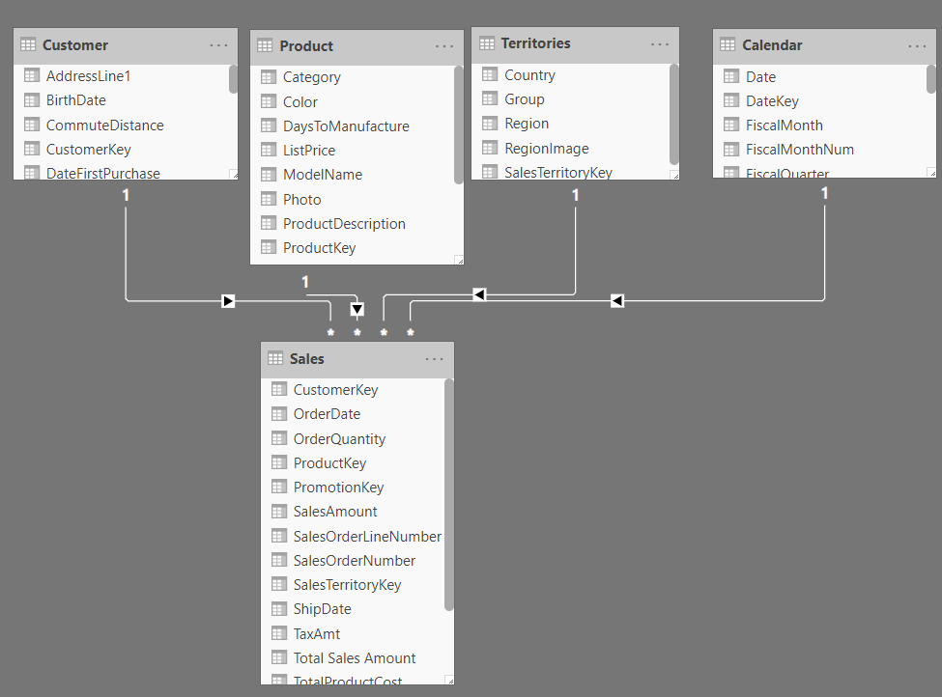
Example 3

Slide 12
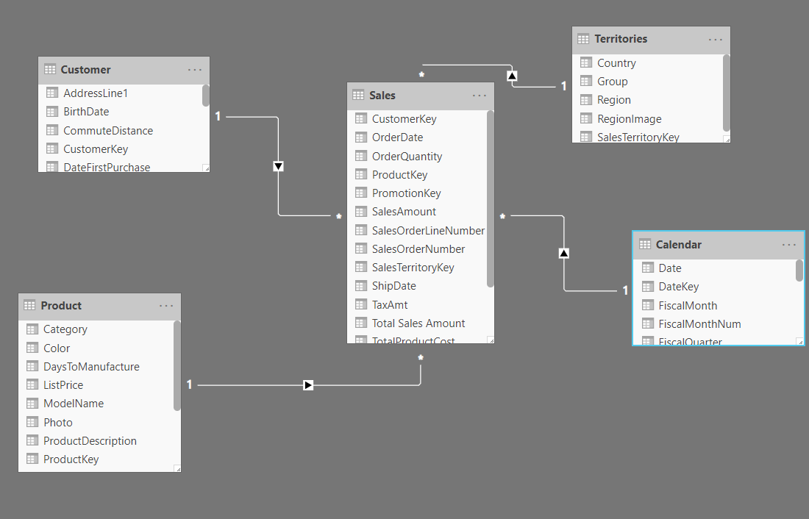
Example 3 – Star Schema

Slide 13
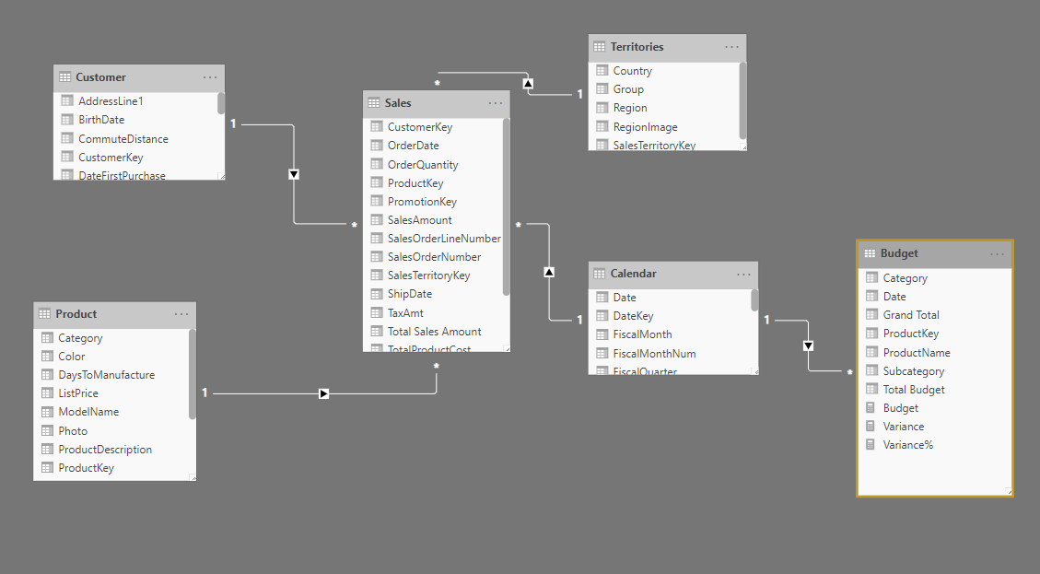
Example 4 – Snowflakes Schema

Slide 14
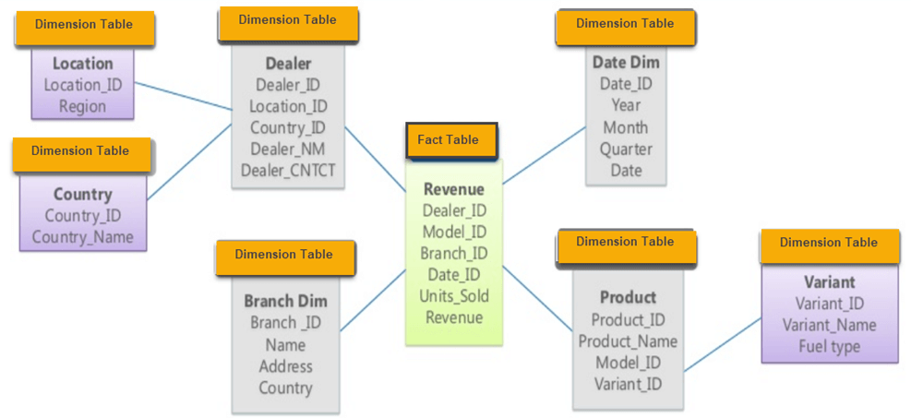
Question – What type of schema is this? Why?
Star Schema
Snowflake Schema
Notes:
snowflake

Slide 15
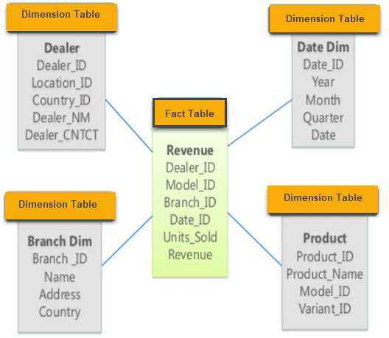
Question – What type of schema is this? Why?
Star Schema
Snowflake Schema
Notes:
star

Slide 16
Normalisation

Slide 17
What is normalisation?
Organise the data into multiple tables to minimise data redundancy (having the same values repeated in multiple places, takes spaces or multiple issues with insertion and deletion updating)
Notes:
1st normal form video https://www.youtube.com/watch?v=mUtAPbb1ECM&t=23s

Slide 18
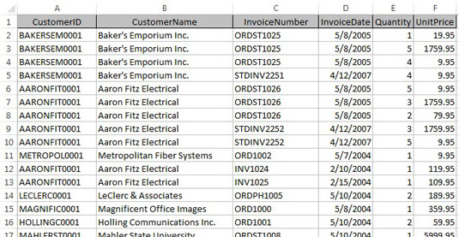
Why normalisation?
“Clean” up the data
Ensure a proper structure of the data
Data consistency (easy to retrieve and input data, better chance to quickly search for data)
Increase quality of the data.

Slide 19
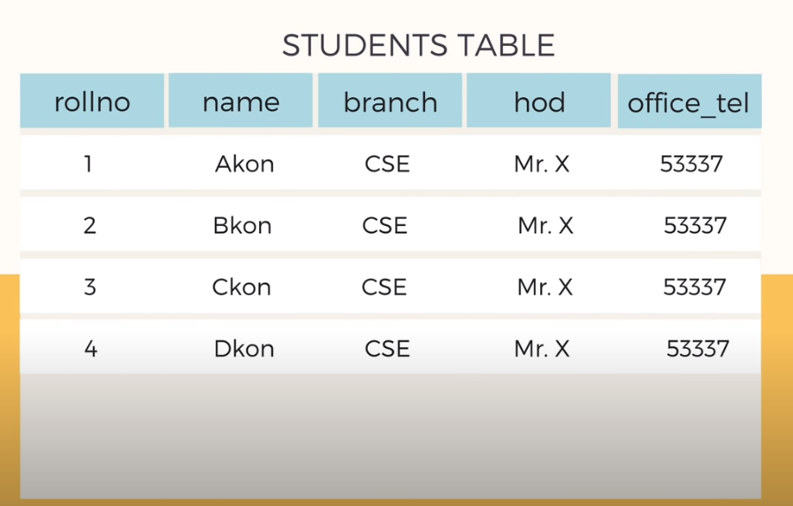
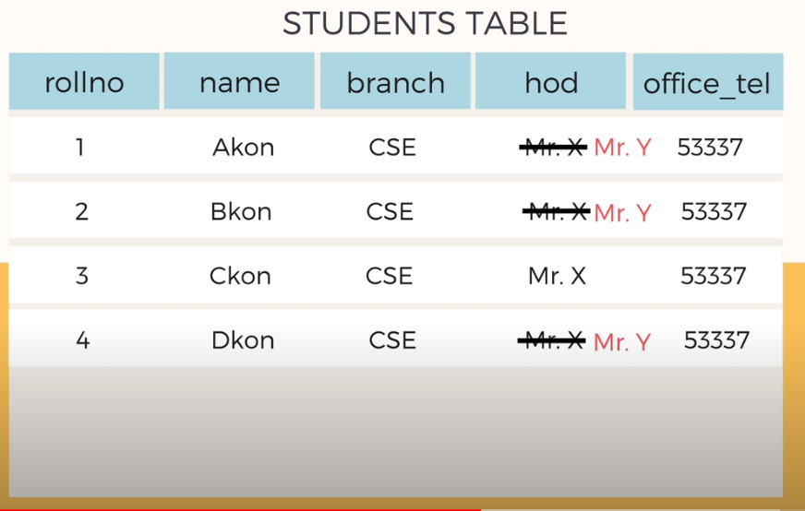
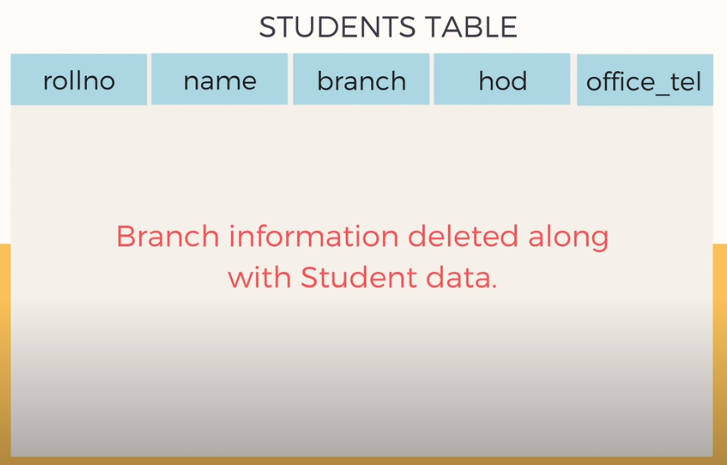
Example
Insertion problem add another student – repeat the data again
Deletion problem – the branch information is gone
Modification problem– you must change all the students records
Notes:
https://www.youtube.com/watch?v=xoTyrdT9SZI

Slide 20
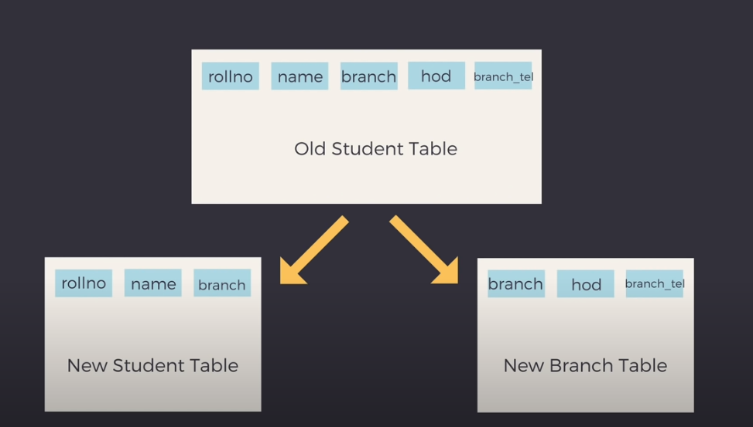
How normalisation can solve these problems

Slide 21
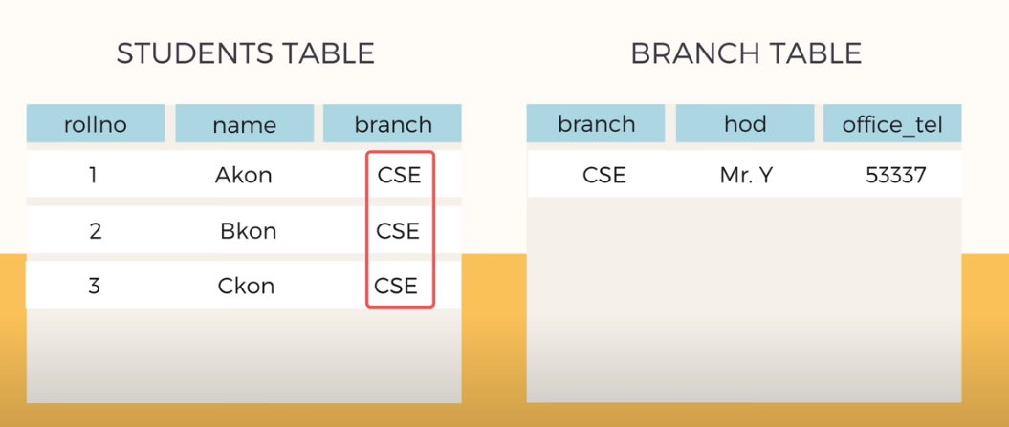
How normalisation can solve these problems
Reducing data redundancy
Notes:
https://www.youtube.com/watch?v=xoTyrdT9SZI

Slide 22
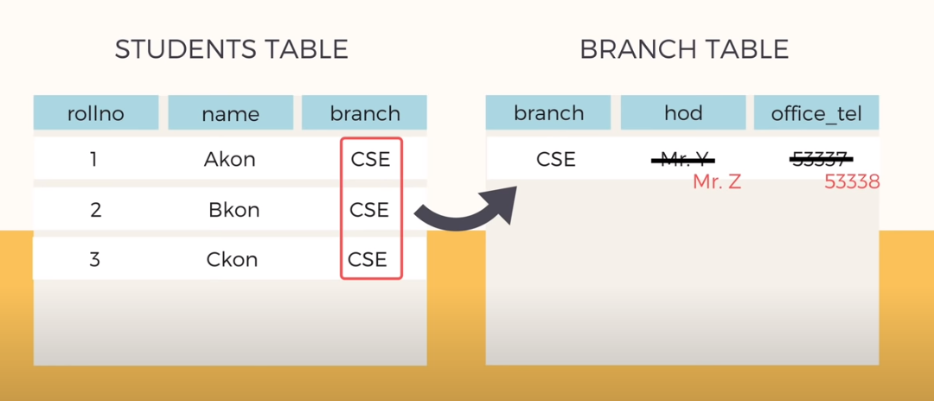
How normalisation can solve these problems

Slide 23
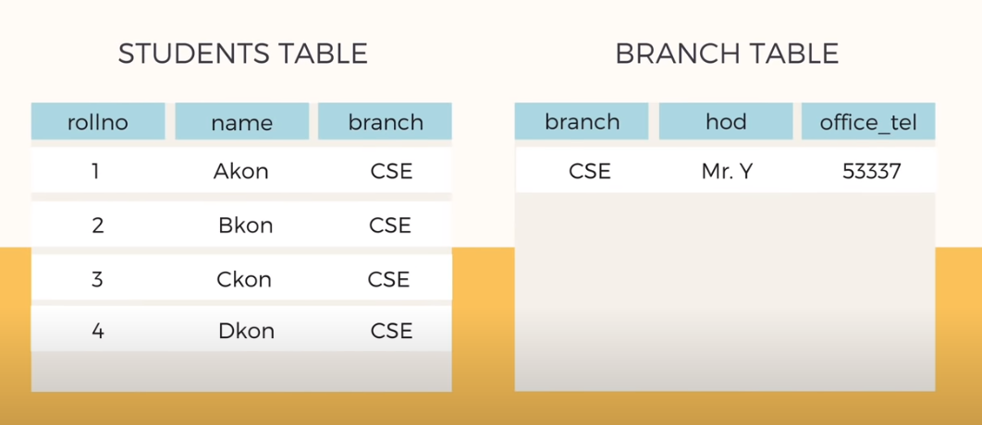
Inserting a new Student

Slide 24
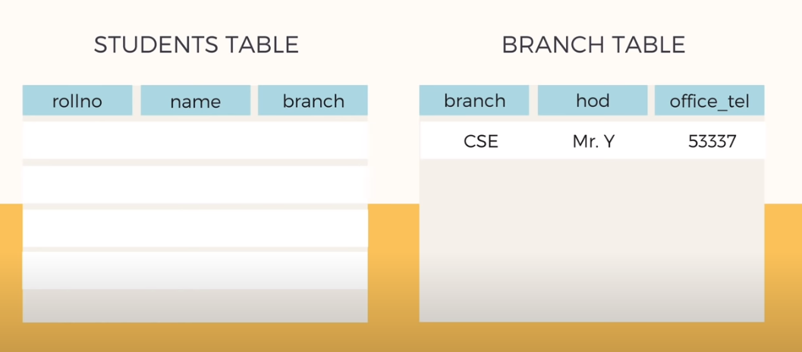
Delete all the students’ record

Slide 25
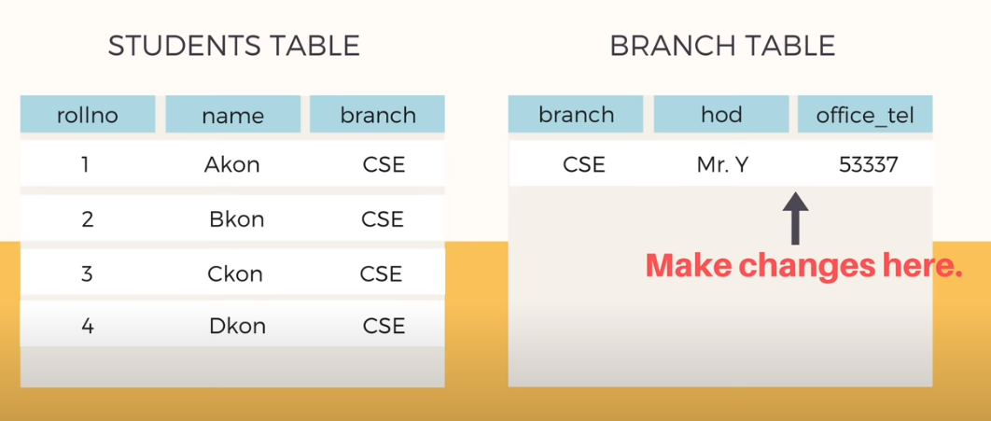
Updating records

Slide 26
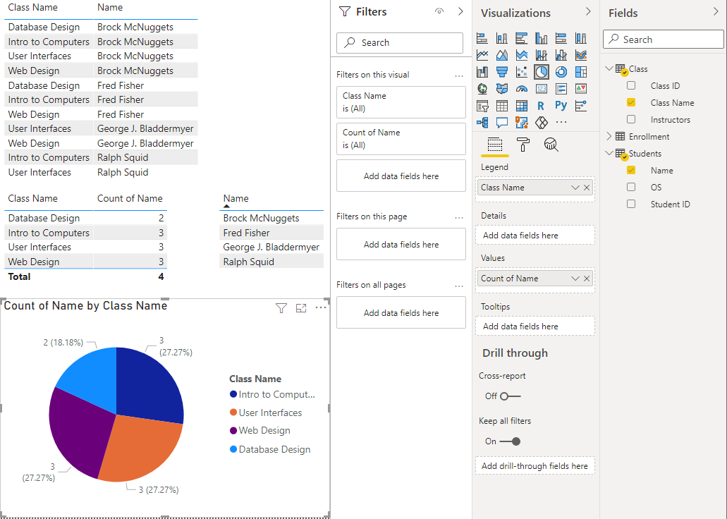
Demo On Power BI
Clean data – from Student 1001 to 1001 (how do I know which steps?)
Import and rename students and classes tables
Remove Duplicates
Create a bridge table (Enrolment)

Slide 27
Relationships in Power BI

Slide 28
What are relationships?

Slide 29
Relationships in Power BI
One to Many
One to One (at the beginning, this is quite common)
Many to Many (try to avoid this, if possible – crossfilter (DAX) or bridge tables)
Direction of relationships
Single
Both
Power BI will do this for you, make sure you check them and change them if necessary

Slide 30
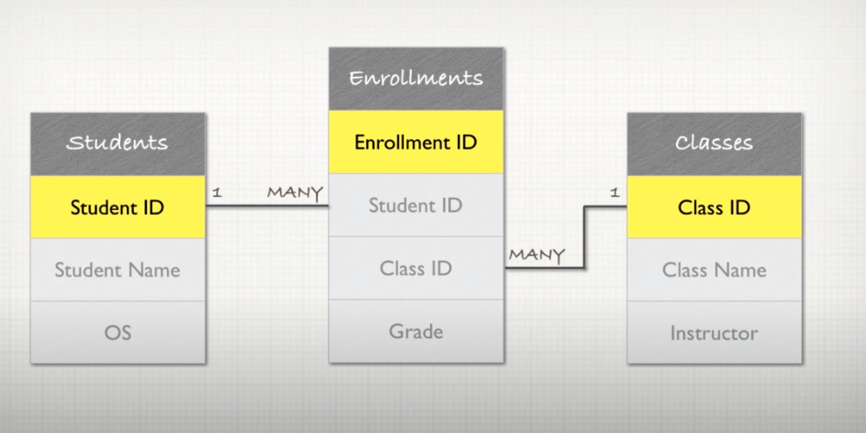
Video on Relational Database Concepts
https://www.youtube.com/watch?v=NvrpuBAMddw

Slide 31
Demo On Power BI
Clean data – from Student 1001 to 1001 (how do I know which steps?)
Import and rename students and classes tables
Create a bridge table (Enrolment)
Remove Duplicates
Detect new relationships (change column’s name)
Table and Pie Charts with and without relationships
Direction of Relationships (how the filter propagates)
What a student usually does…(no bridge table)
Many-to-Many problems (change into Count (distinct))

Slide 32
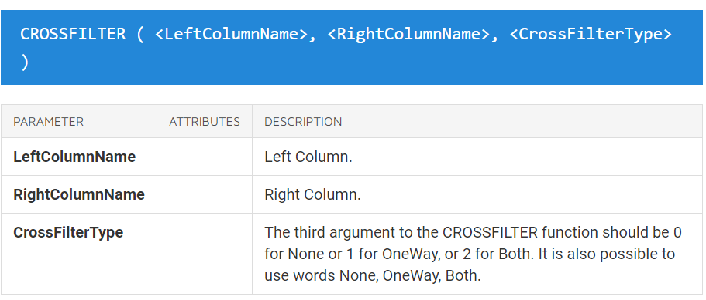
Both-directional relationships in Power BI
They can lead to performance issues
Can you change your model?
CROSSFILTER function (DAX) for a specific measure – both direction only for that specific measure.

Slide 33
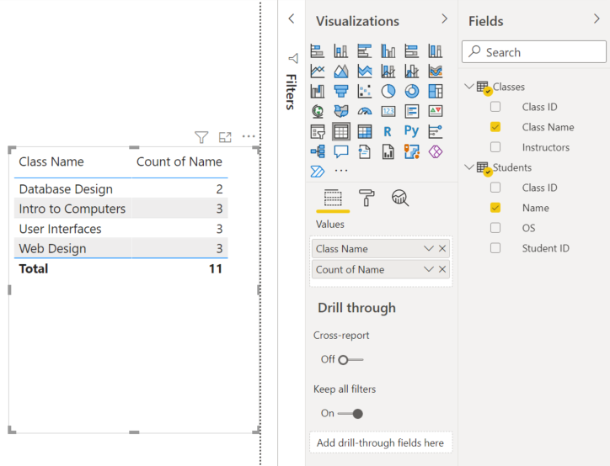
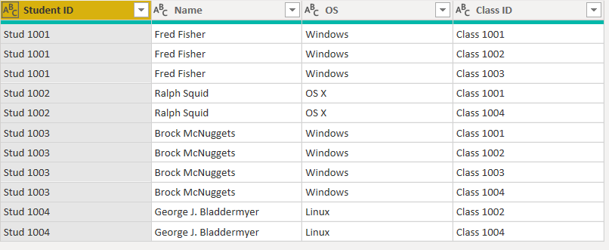
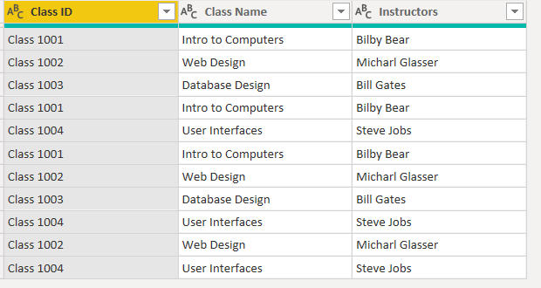
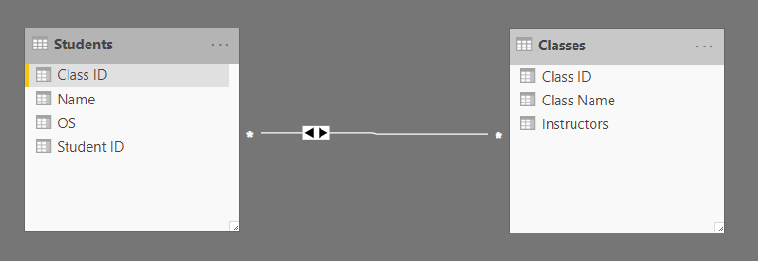
Why you should avoid many-to-many

Slide 34
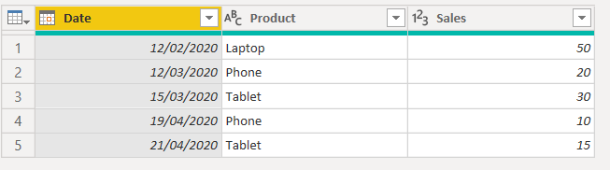
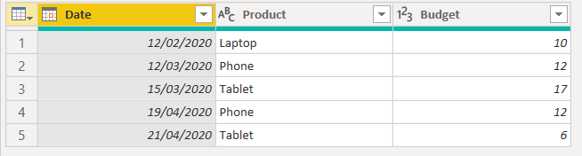
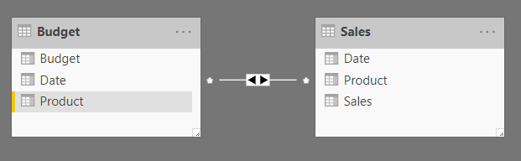
Why you should avoid many-to-many

Slide 35
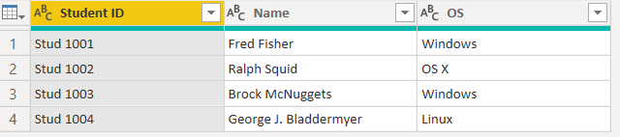
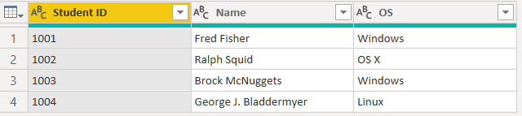
Question – How would you do this in Power BI?
You need to modify the Student ID column…
From the Format menu, click Trim
From the Extract menu, click Last Characters
From the Extract menu, click Text After Delimiter
From the Split column menu, click by delimiter
To look like this…
Notes:
Trim – removes blanks
2) Extract the last characters
3) Correct
4) You will end up with two columns, but this is not what you want

Slide 36

Recap on data modelling and bi-directional relationships
Link: https://www.kasperonbi.com/on-demand-webinar-strengthen-your-data-modeling-skills-with-power-bi/

Slide 37
Knowledge - Checkpoint
What is a data model (examples)
Data Normalisation
Relationships in Power BI

Slide 38
ICA Focus – What is a KPI?

Slide 39

KPI: formal definition
A Key Performance Indicator is a measurable value that demonstrates how effectively a company is achieving key business objectives.
Link to Youtube video: https://www.youtube.com/watch?v=HJNHT_1aUao&feature=emb_logo

Slide 40
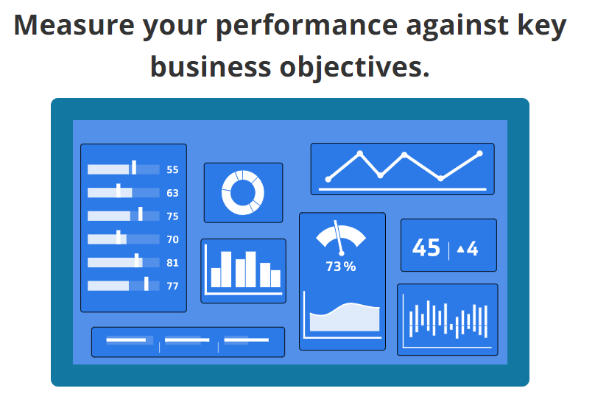
Key Performance Indicator (KPI)

Slide 41

A few points to consider…
What is the objective?
Measurable
Inspires action

Slide 42
How to define your KPI?
Depends on the data you have
What questions you want to answer?
Examples
How much has our revenue grown this month?
How is our website performing?
When should I order more stock?

Slide 43
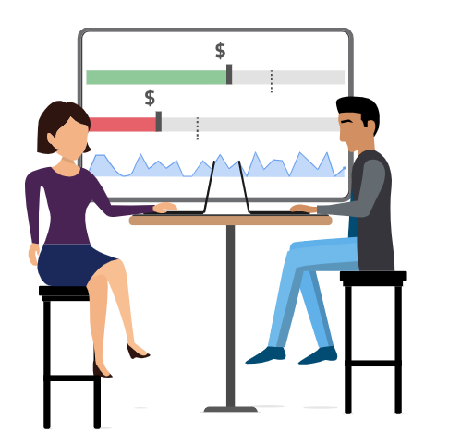
Define the right aggregators:
SUM/AVERAGE/MIN or MAX
Is your KPI based on data that changes
over time?

Slide 44
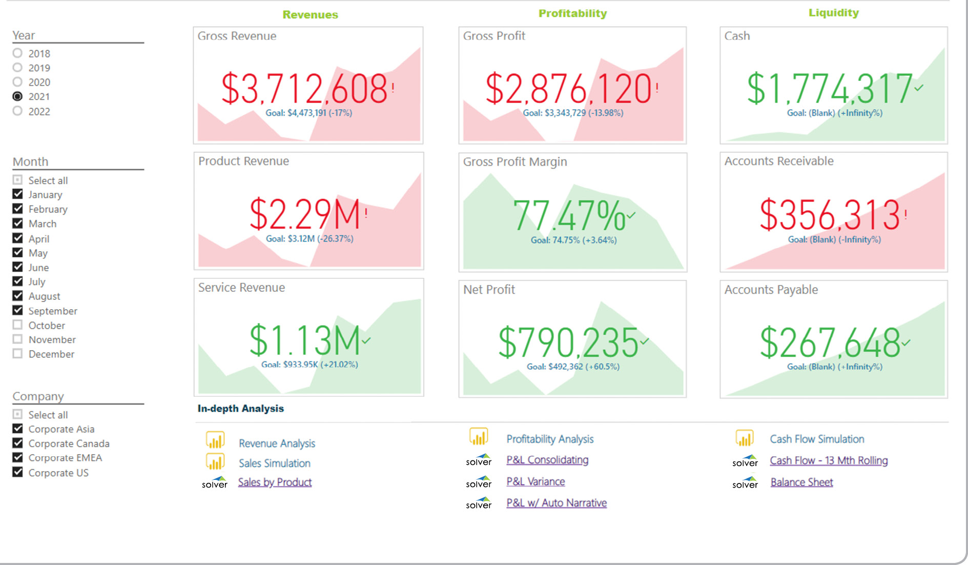
Power BI Example

Slide 45
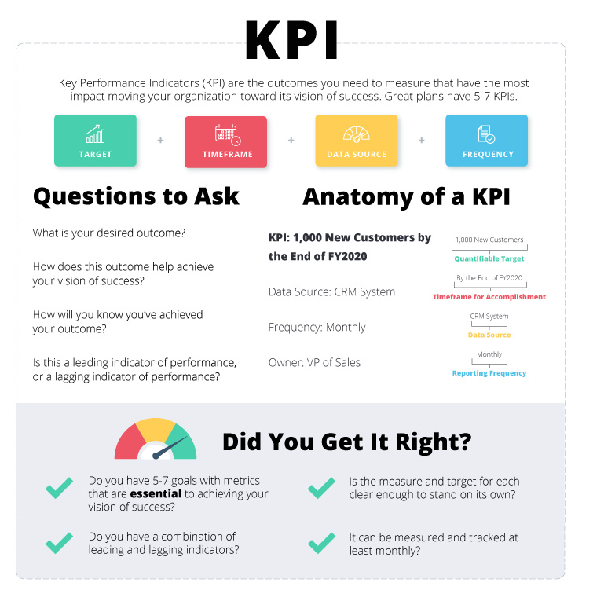

Slide 46
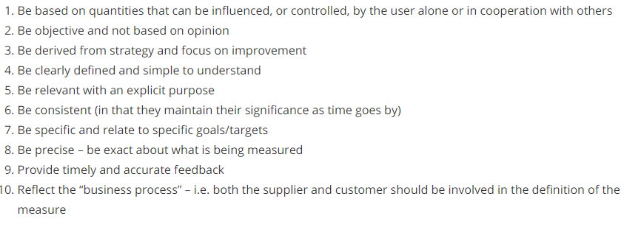
10 things to consider when designing KPIs

Slide 47
Extra Resources
1) What are KPIs (video) https://www.youtube.com/watch?v=syI-oRnjROU
2) What is a KPI (article) https://www.klipfolio.com/resources/articles/what-is-a-key-performance-indicator
3) Examples of KPIs https://onstrategyhq.com/resources/27-examples-of-key-performance-indicators/
4) How to select your KPI https://www.clearpointstrategy.com/18-key-performance-indicators/

Slide 48
Questions?
Feel free to contact me on Teams or email me
a.occhipinti@tees.ac.uk

